Slide 1




Girl Boss HQ

Slide 2

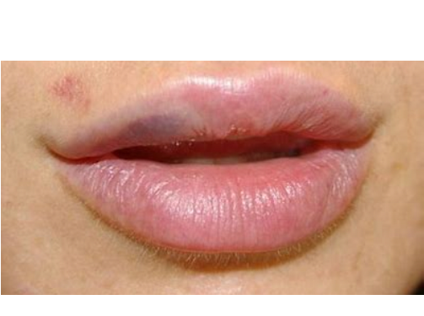
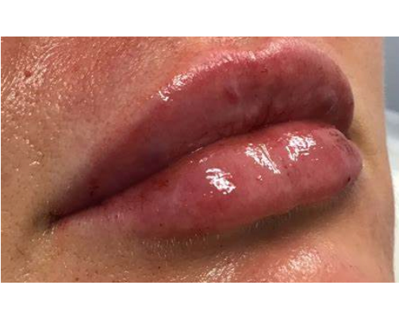
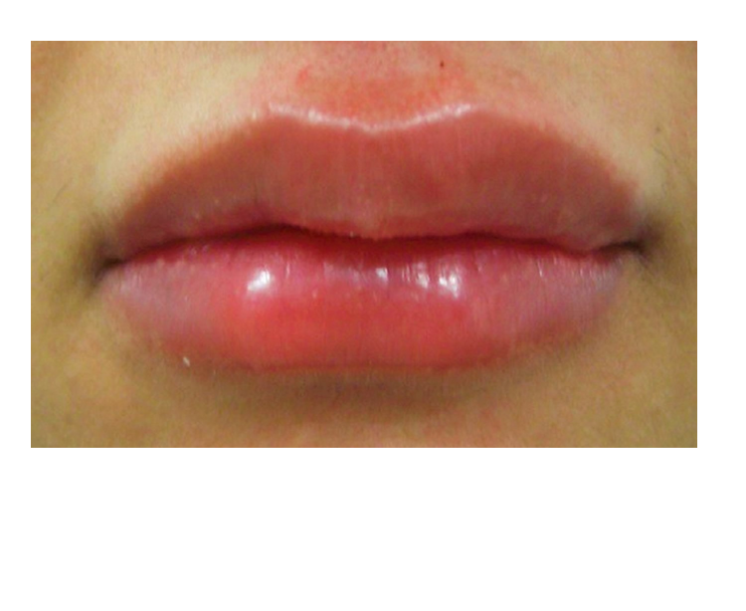
Bruising
Piercing of the blood vessel.
Treatment - heals over time, use arnica gel to speed up healing.
Redness and Swelling
Normal inflammatory response.
Treatment - resolves within several hours, swelling may take longer but cold
compress can help.
Detectable Filler
Client will feel presence of the filler.
Treatment - if the filler is irritating or uneven the client can massage it.
Pain
Will resolve within minutes, this is the filler being injected.
Treatment - if not resolves within minutes then consider complications.

Slide 3
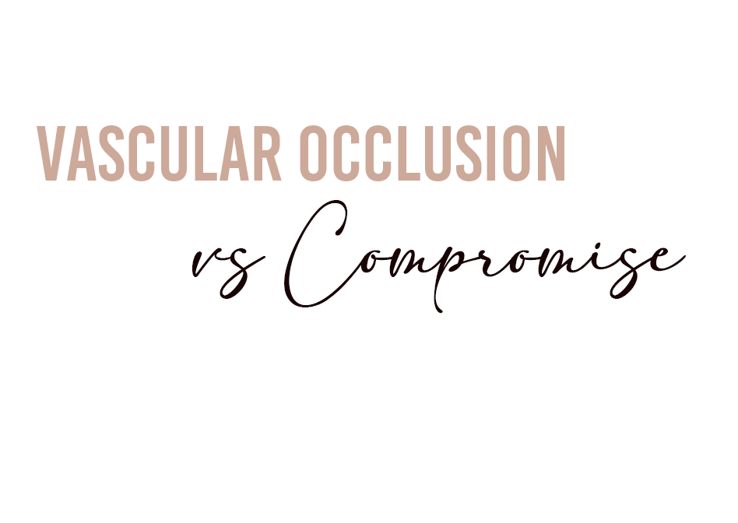
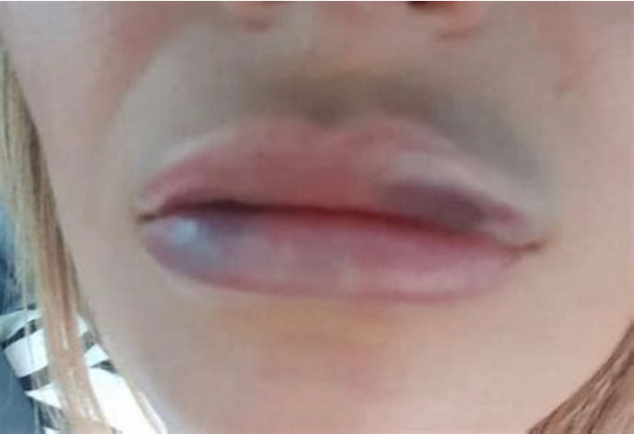
What is a Vascular Occlusion/ Compromise?
This is caused when the dermal filler is either injected into the
artery or around an artery to the point blood flow is reduced or
completely stopped. The area of the skin or tissue that are supplied
by the affected vessel will start to 'die' without the necessary
blood supply.
There will be immediate blanching (paleness, white tissue) when
the blood flow is interrupted.
Pain us usually associated with vascular occlusions.
What to look out for when this occurs, if left untreated
The skin will begin to appear dusky, blush tint.
Fine reticulations (lace like small veins) to areas well beyond the site if injection.
How to treat
Dissolve it, massage the area, blood thinners, hot compress, treat within 24 to 48 hours.

Slide 4

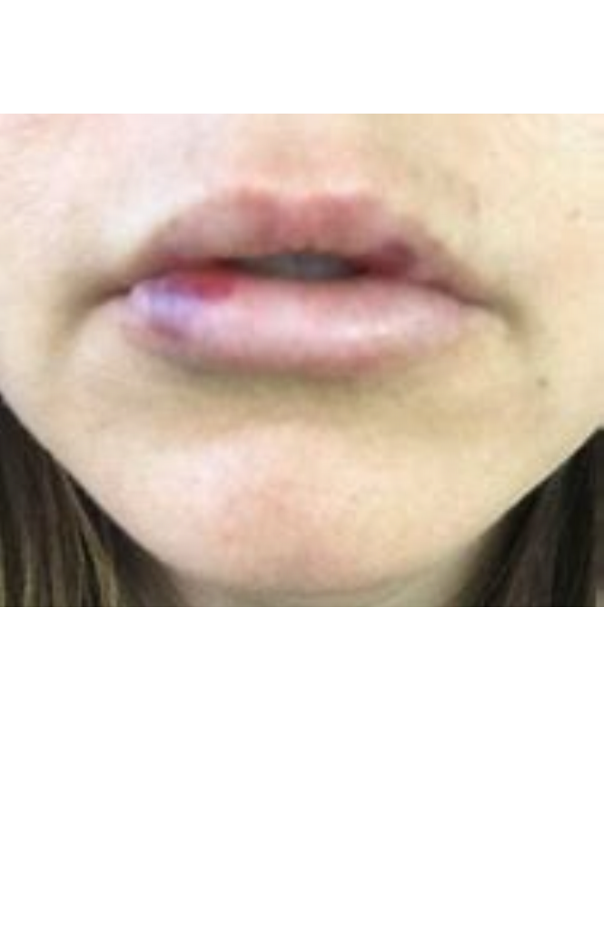
What is a Hematoma?
A Hematoma is a collection of blood outside of a blood vessel, It
occurs because the wall of a blood vessel wall, artery, vein or
capillary has been damaged and blood has leaked into tissues where
it does not belong.
Symptoms
Painful swelling.
Blood bubble surfacing on the lip.
Puffiness.
How to treat
Cold compress on the area, medications to swelling.
How to prevent causing a Hematoma
Every clients A & P is individual therefore it is important to assess your client before and during injecting.
Some blood vessels are not visible.

Slide 5

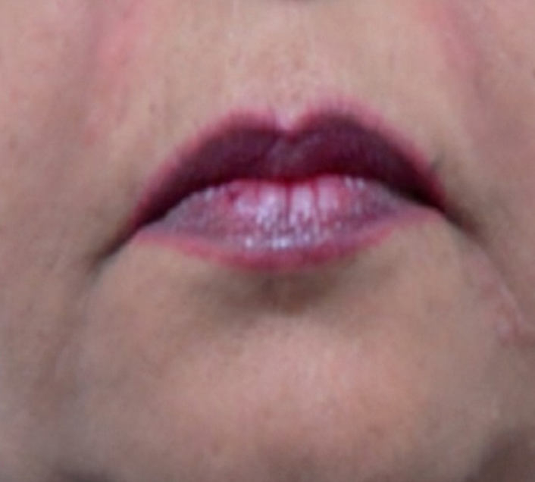
What is the Tyndall effect?
The Tyndall effect is where dermal filler product appears blue underneath the surface of the skin due to a light scattering of the particles within the dermal filler.
What causes this 'blue effect' to occur
When there is a lump of product under the skin.
When dermal filler is placed too superficially.
When the client has very fine skin in the treatment area.
How to avoid
Avoid depositing a large amount of product in one area.
Go deeper with needle technique.
How to treat Tyndall Effect
Massage the area.
Hyaluronidase to dissolve.

Slide 6

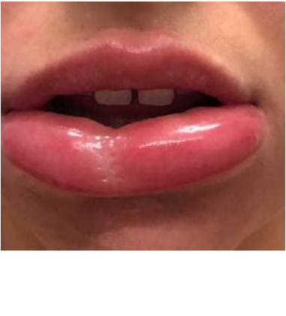
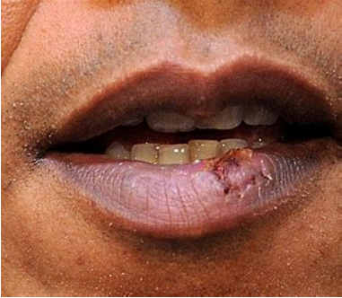
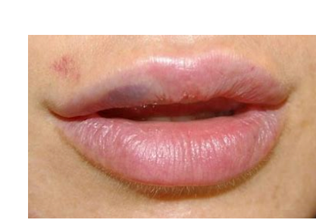
Anaphylaxis
Immune hypersensitivity.
Treatment - if trained to use an epi pen administrate, if in doubt call 999.
Allergic Reaction
Immune hypersensitivity.
Treatment - ensure this isn't anaphylaxis, antihistamines may help or reversal maybe required.
Herpes Simplex
Existing one is triggered into action by minor trauma in the infected area.
Treatment - allow to heal overtime the following week or client can treat with Acyclovir
ointment or tablets from their GP.
Discolouration
Injecting too superficial above the papillary dermis.
Treatment - massage the area or allow to dissolve on its own, or dissolve.

Slide 7
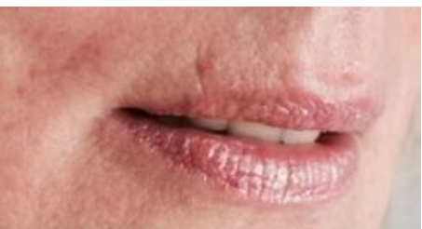

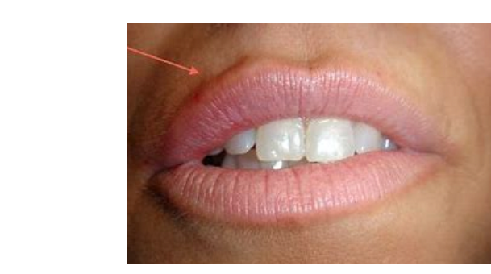
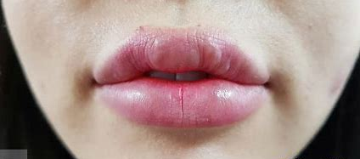
Under Correction
Inexperience or too little filler used.
Treatment - further treatment with more filler will resolve the issue.
Over Correction
Poor judgement when applying filler.
Treatment - massage the area in clinic and ask the client to continue this at
Home or reverse the filler with hyaluronidase.
Asymmetry
Poor injection technique.
Treatment - a firm massage on the over treated side or apply more filler.
Filler Nodules (appear after 4-6 weeks)
Poor injection technique or product migration.
Treatment - massage the area or dissolve. This is common in lips.

Slide 8
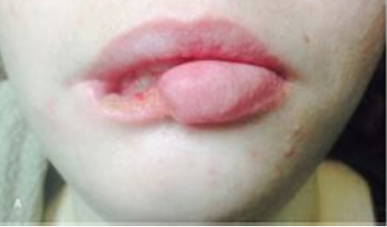
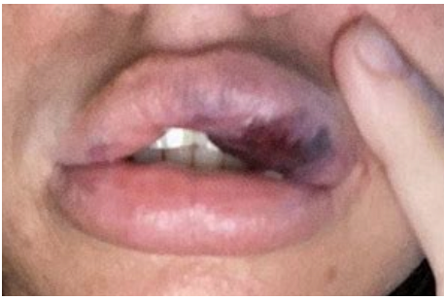
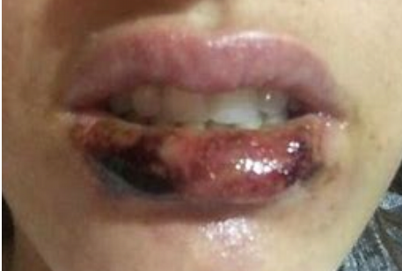
Emobolisation
This is when the filler has blocked a major artery
Treatment - reverse immediately
Infection
Cross contamination
Treatment - if the area looks red and indurated at any point, dissolve immediately.
Impending Necrosis
Caused by an undetected embolisation or compression of an artery
Treatment - dissolve immediately
Necrosis
Blood supply to the area has been stopped and the tissues died.
Treatment - dissolve immediately

Slide 9
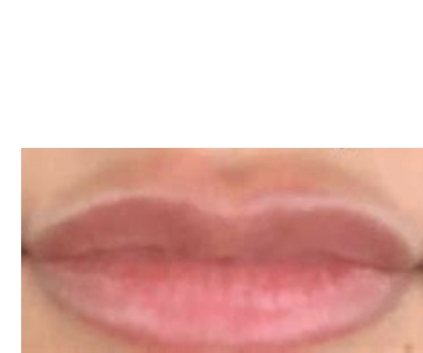

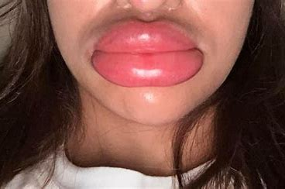
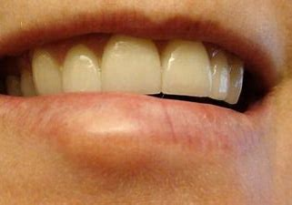
Migration
Repetitive mechanical force
Treatment - can sometimes be relieved with massage or can be dissolved.
Infection
Cross contamination, infection that has spread from superficial skin lesions.
Treatment - dissolve the filler and then antibiotics
Swelling and Puffiness
Late onset fluid attraction by hyaluronic acid
Treatment - massage regular or dissolve
Granuloma after 4 months of treatment
Late onset red smooth bump that can persist for several years
Treatment - Refer for steroid injections

Slide 10

1. Know your anatomy well and understand that everyone is different.
2. Look for a flash back before injecting.
3. Never inject deeper than necessary.
4. Inject the filler slowly.
5. Inject small amounts of filler at a time.
6. Be careful with the total volume used as compression is more likely to occur when you use a lot of a firmer filler.
7. Check capillary refill after treatment.
8. Keep an emergency pack to hand at all times.
9. Ensure you advise your clients of how to seek medical attention if required.
10. Give appropriate after care advise.

Slide 11

Necrosis is the most serious side effect after anaphylaxis, it is the death of tissue in the body when it is not getting enough blood. Necrosis can occur in two possible ways, the first is from a direct embolisation of an artery and the second is from compression, necrosis damage can not be reversed.
Embolisation is where the needle cannulates the artery whilst injecting filler and fills the arterial tree. It is
believed that worse case scenarios are caused by retrograde embolisation where the filler flows back down the
arterial tree into a bigger vessel which can cause the filler to travel to other parts of the anatomy such as the eye.
Necrosis Time Line - Case Study
This particular client had been having Radiesse in their left cheek for several years to correct muscle loss from a car accident. On this particular occasion white bumps formed at the site of injection and she was advised that it was
from the lidocaine in the Radiesse and that it would resolve itself over the next hour.
A few hours later she contacted the practitioner who advised her to massage it. The following morning, she
woke up with severe swelling and bruising. She called the practitioner again, only to be advised that this would
go down in the following days.
Visit https://www.realself.com/review/redding-ca-radiesse-side-effects?sort=oldest for the full story.

Slide 12

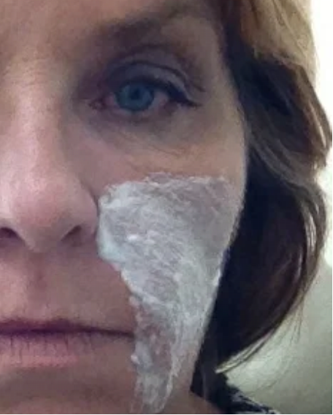
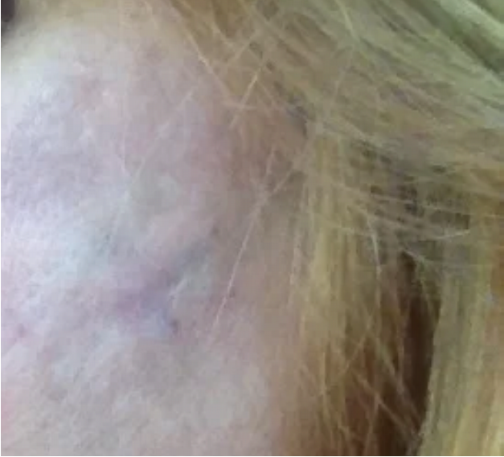
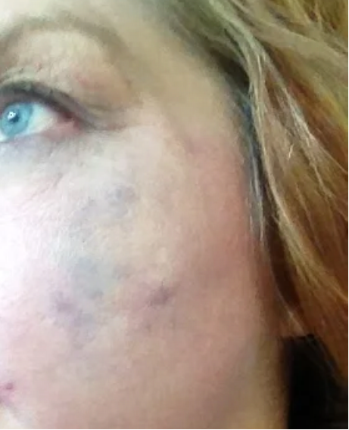
Numbing cream before Radiesse
A few hours after injections
4th day after injections
12th Sep 2013
12th Sep 2013
16th Sep 2013

Slide 13
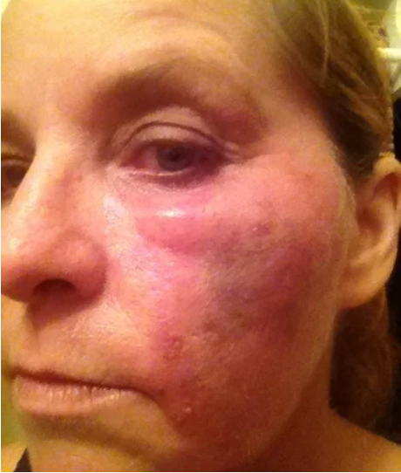
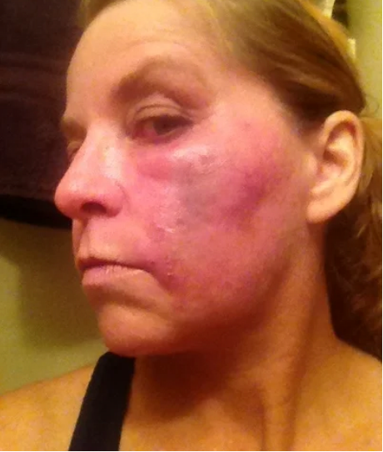
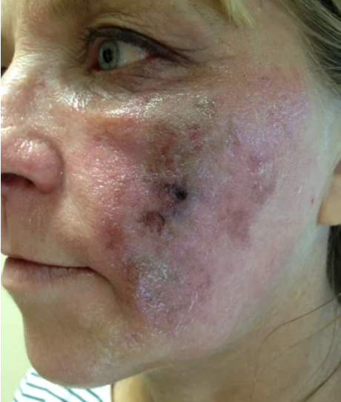
Raw and burning skin - Day 6
Fluid building under the eye
Client was told to wait before
seeking medical attention
19th Sep 2013
18th Sep 2013
18th Sep 2013

Slide 14
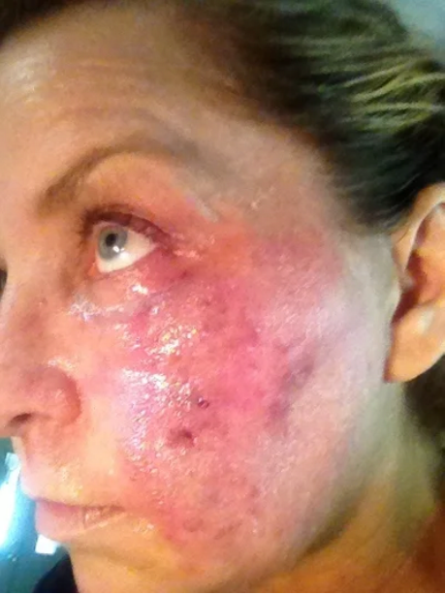
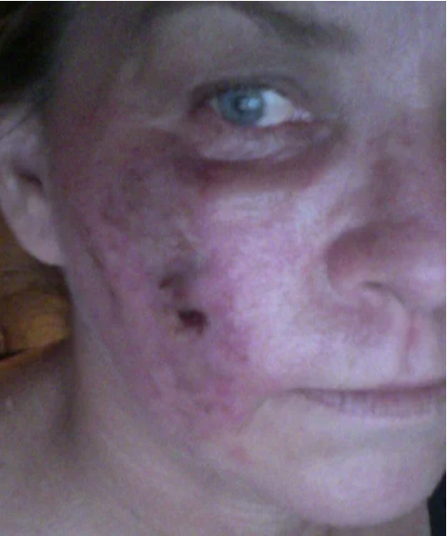
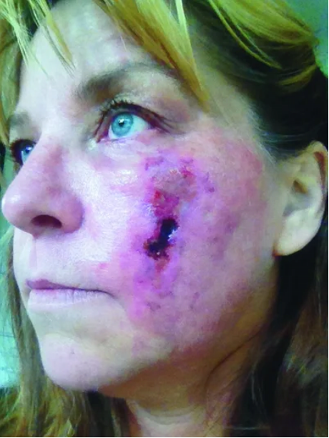
20th Sep 2013
21st Sep 2013
22nd Sep 2013

Slide 15
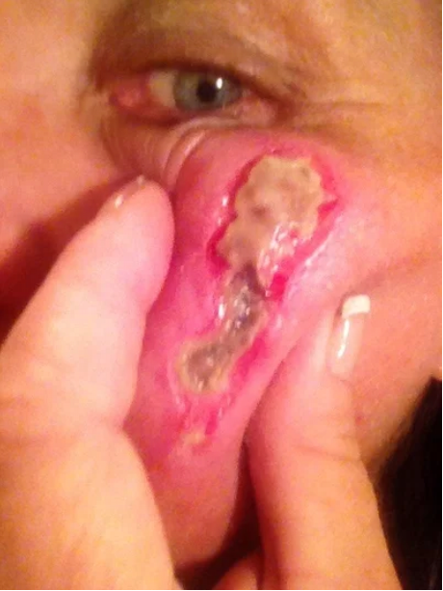
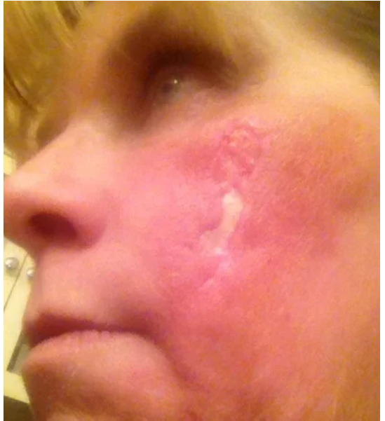
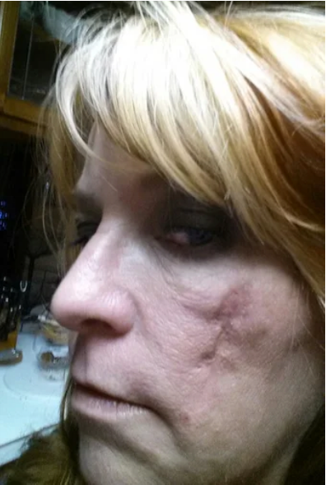
30th Sep 2013
14th Oct 2013
13th Dec 2013

Slide 16

Complications
To a greater or lesser degree, all dermal fillers are associated with certain risks. Beyond the common
complications of redness, bruising and swelling, there are important risks that patients should be consented for.
Allergic Reaction
It is not always known If a client is allergic to the dermal filler you are using. It is important to observe your client carefully, throughout the procedure, watching carefully for signs of allergic reaction.
Acute infections
Infections such as bacterial, viral are acute as they typically clear up on their own or with the help of anti biotics. Reactivation of herpes virus may also be experienced.
Infections, whether they are acute or chronic, remain a lifetime risk for all patients injected with fillers.
Direct arterial embolisation
Can lead to tissue necrosis, especially in the glabellar supratrochlear arterial branches, the labial artery, the nasal dorsal artery and the angular vessels along the line of the nasolabial folds.
Direct arterial embolization leads to immediate skin blanching and pain.

Slide 17
Compromise of the venous circulation
Can be seen from compression due to large filler quantities, and this causes a persistent dull aching, swelling and a patchy discolouration of the skin. This is most commonly seen in the region of the angular vessels along the line of the nasolabial fold. A lack of anatomical knowledge in non-professional injectors will inevitably lead to a higher risk of these complications.
Vascular compromise
It can occur with any filler and can be minimised with the use of small gauge needles (30g) and injecting with a needle withdrawal technique. Immediate treatment of vascular compromise is to stop injection, attempt aspiration, vigorous massage to distribute the filler widely, the use of warm compresses, you can dissolve if you are worried.
Best way to reduce risk
Aspiration prior to injection can help identify a blood flashback and hence location of the needle tip within a blood vessel.

Slide 18

Girl Boss HQ

Slide 19
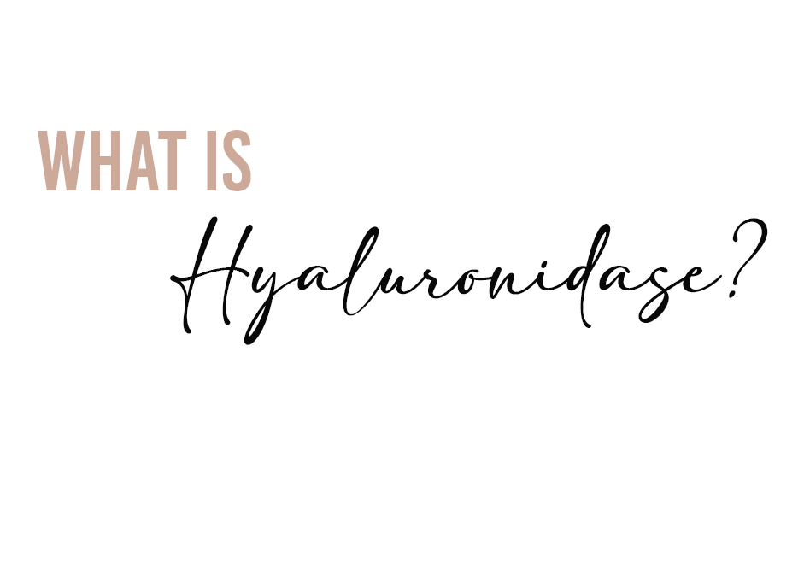
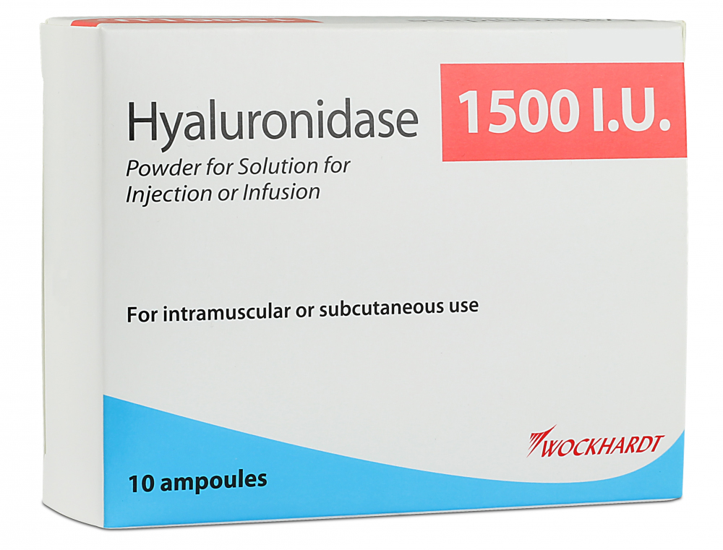
Hyaluronidases are a family of injectable enzymes that act as dispersion agents. These help speed up the natural breakdown of hyaluronic acid in aesthetics, it is widely used ‘off license’.
Off license does not necessarily mean it is unsafe to use, but that it is being prescribed and administered in a way that is different to its licensed use. The license is obtained from the Medicines and Healthcare products Regulatory Agency4 (MHRA) and will state what the drug can be used for, how much to give and the age of patients suitable to be treated with it.
As long as the practitioner is acting in the patient’s best interests, their autonomy is respected and the patient has fully consented, then hyaluronidase can be administered in the event of an adverse reaction.
Due to this ‘off license’ use of hyaluronidase, practitioners can only seek guidance from other professionals (as well as use their own expertise) in order to judge how much hyaluronidase to use and how to reconstitute it, which can be limiting if one has little experience of using it.
Various factors will influence the administration and dosage – for example, the concentration of HA filler, level of cross-linking and amount of HA deposit

Slide 20

Vascular occlusions are very rare when carrying out dermal fillers, however the possibility is ALWAYS THERE.
We want you to feel prepared should it ever occur.
A vascular occlusion is caused when the dermal filler partially or fully blocks an artery. This then leads to a blood flow compromise which means there are skin tissues that are being deprived of oxygen. Its much scarier than it sounds and our job is to help you feel comfortable recognising the signs and feel confident enough to deal with this. Please note we will always be on hand to support you all with anything after your course
Immediately after injection the area of the lip became instantly bruised and started to swell. Initially this presented as a normal bruise with the expected amount of swelling.
On closer inspection we could see that the vessels under neath were very dark and seemed to be getting darker by the minute.
At this point a thorough review of your client is VITAL. We would be asking about the pain levels, is the pain mild or severe, is it getting better or worse?
If a vessel is occluded we would expect worsening pain, however please are in mind that you client could still be numb from the treatment.

Slide 21
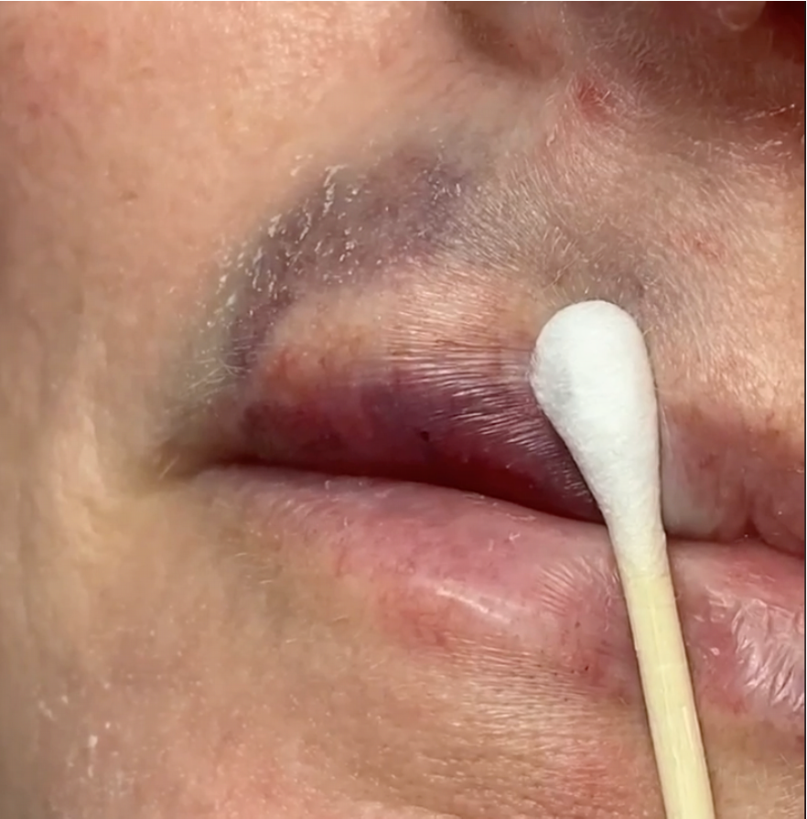


You can check a clients capillary refill by applying pressure for 5-10 seconds, here we are just using a cotton swab to apply the pressure.
Once we release the swab we will count how many seconds it takes for the area to turn back to normal skin colour.
Three seconds or less in a good indication that the blood flow is ok.
Anything longer than three seconds we call “ sluggish" which would be a cause for concern.

Slide 22
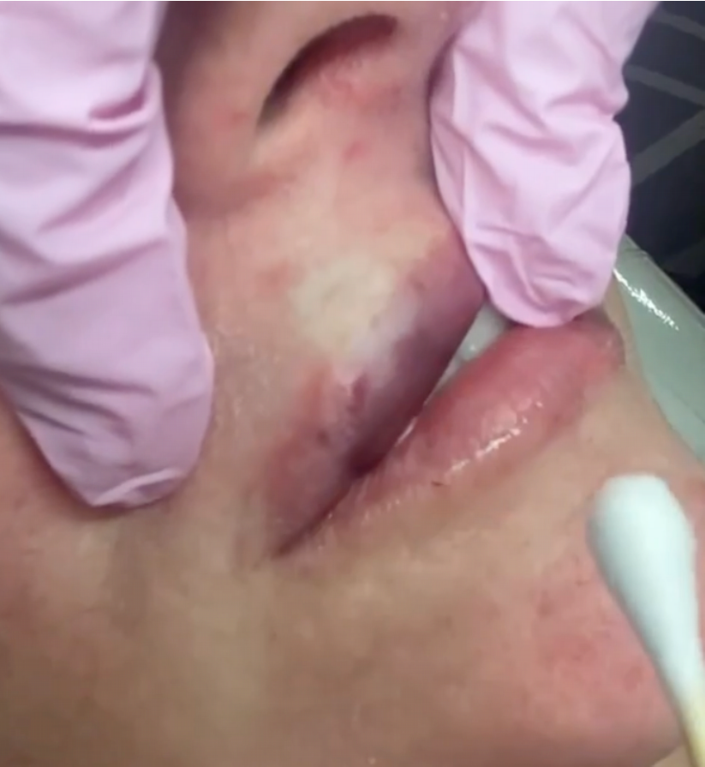


As you can see here, the colour has taken a while to return.
Capillary Refill!
We had a capillary refill time of 4-5 seconds each time we checked.
There was also a slight temperature change above the top lip.
This can be a sign of compromised blood flow too.
The swelling was continuing and the pain was getting worse.
We made the decision to emergency dissolve.

Slide 23

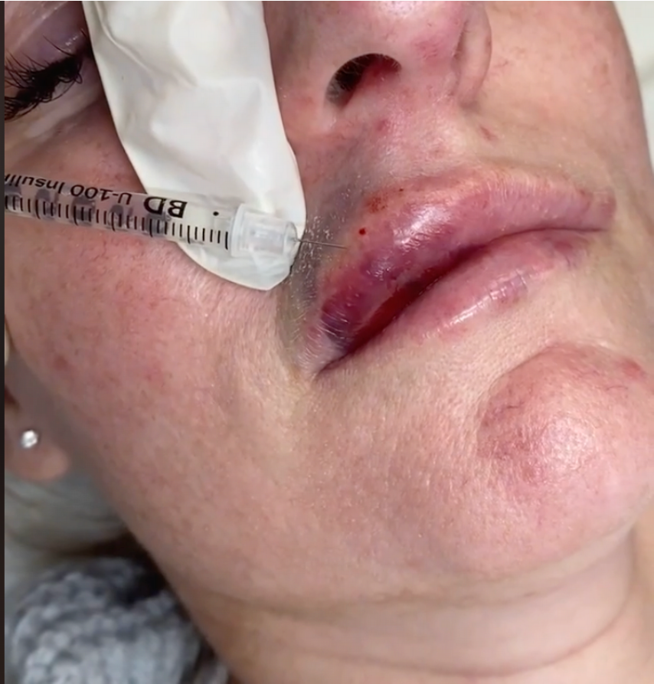








The first thing we did was discuss the complication with client, we explained what we needed to do next and we gave the client a separate consent form to sign.
Download your hyaluronidase form from your portal!
We then mixed up 1ml saline into 1500iu of hyaluronidase, drew this up into insulin needles and began injected in and all around the area.
To completely restore blood flow it can take anything from 1-10 vials of hyaluronidase, this occlusion only took one vial and the blood flow returned very fast!

Slide 24
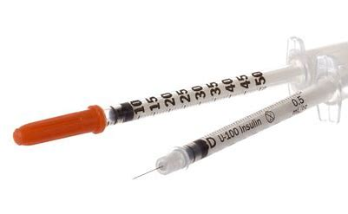
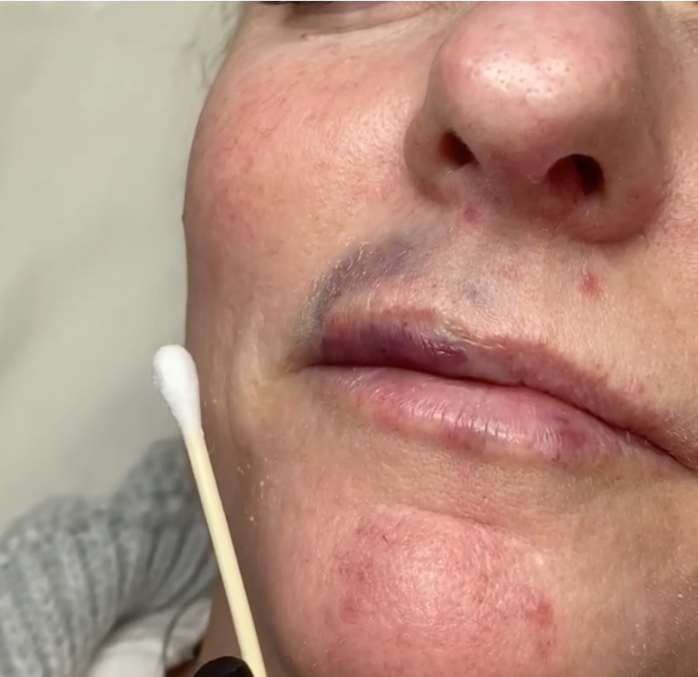
When injecting, you completely flood the compromised area with a 8mm insulin needle
This picture was taken 15 minutes after dissolving and as you can see the bruising and the swelling went down pretty much instantly!
Don't forget there's a full demo video on your portal showing you how to mix it up!

Slide 25

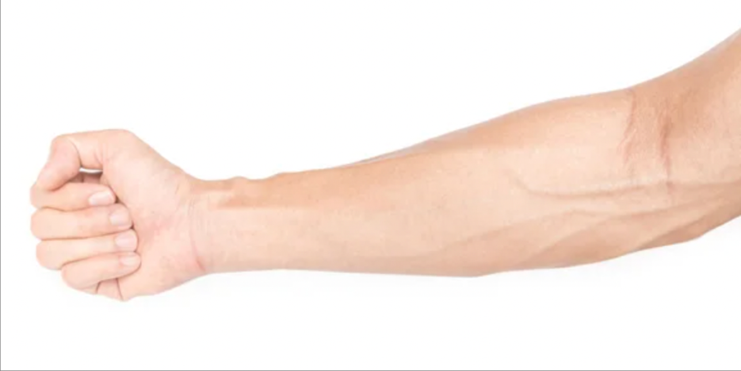


20 Units of hyaluronidase in one side of the forearm.
20 Units of saline in the other side of the forearm.
Wait 20 minutes to check for any reaction.

Slide 26


Are there any changes in skin colour?
Are there any changes in temperature of
the skin?
What is the capillary refill?
Does the client feel any numbness?
Any pain?
How is the swelling?

Slide 27

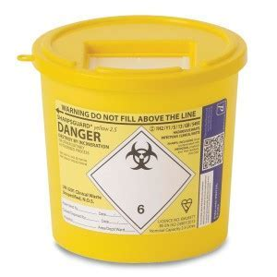
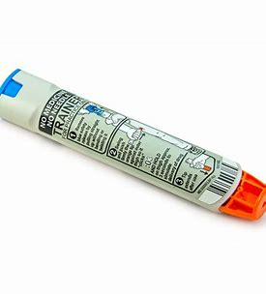
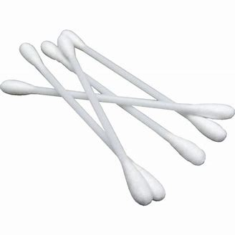
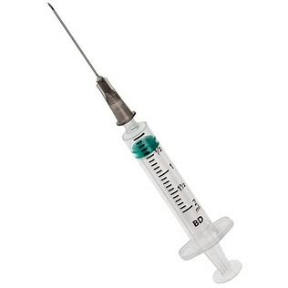
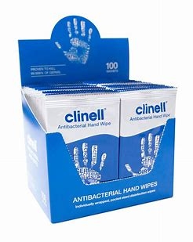
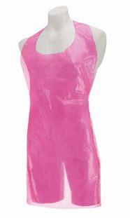
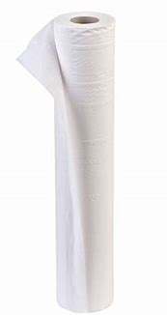
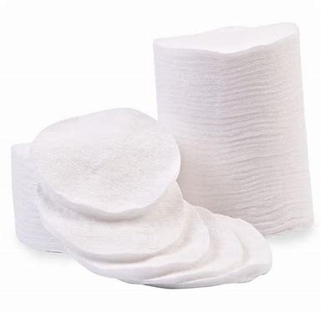
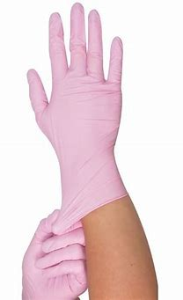
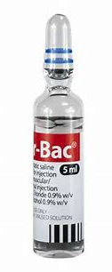
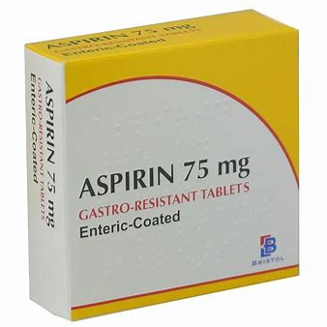






Slide 28

An emergency kit is essential for anyone performing aesthetic treatments as in the event of a medical emergency, there is not enough time to prescribe and order the drugs required to treat it.
According to Regulation 238 of the Human Medicine Regulations 2012, anybody can inject adrenaline and other drugs listed in Schedule 19 of the Regulations for the purpose of saving a life without breaking any laws however this does not get around the issue of how to obtain these drugs in the first place.
When working with fillers an emergency pack should be kept to hand in the event of any complications.
Allergy test recommended before using Hyalase. Once mixed, draw up a small amount in Botox syringe and inject small bleb intradermally on inner forearm and leave for a few minutes to see if reaction.

Slide 29

One complication following the administration of hyaluronidase is allergic reaction. There appears to be conflicting
evidence as to whether a patch test of hyaluronidase should be carried out to rule out evidence of allergic reaction, with several practitioners suggesting that when it is used for elective treatments a patch test should be carried to minimise the risk.
The patch test should be done intradermally (within or between the skin) and is advised for the practitioner to look for
signs of inflammation, erythema and persistent itching. However, if the patient is showing signs of a vascular compromise then it could be justifiable to use the hyaluronidase as soon as possible to lower the risk of further harm.
Another possible side effect of hyaluronidase is its potential to degrade the body’s natural hyaluronic acid in preference to the foreign hyaluronic acid filler that has been injected. I would therefore recommend treating the effect rather than absolute dosage, to go slow and to bring the patient back for additional treatments. Following the use of hyaluronidase, observe the patient for 30 minutes in a clinical environment and making sure they have appropriate aftercare information.
Results are often seen almost immediately, although for denser, more cross-linked products it may take 48 hours for the effects to be seen. A review appointment at two to three weeks should be booked and further treatment offered at this point if needed.

Slide 30

What is anaphylaxis?
Anaphylaxis is an extreme allergic reaction. The whole body is effected. often within minutes of exposure to
the substance which causes allergic reaction but sometimes after hours.
What can cause anaphylaxis?
Common causes include foods such as peanuts, tree nuts, sesame, fish, shellfish, dairy products and eggs.
Non food causes include wasp or bee stings, latex, penicillin or any other drug or injection in some people,
exercise can trigger a severe reaction.
What are the symptoms of a severe allergic reaction?
Generalised flushing of the skin, nettle rash (hives) anywhere on the body. sense of impending doom,
swelling of the throat and mouth, difficulty in swallowing or speaking. Raised heart rate, severe asthma,
stomach pains, nausea or vomiting. Feeling weak, drop in blood pressure, collapsing or unconscious.
Clients would not necessary experience all these symptoms in the same episode.

Slide 31

What does anaphylaxis occur?
Any allergic reaction, including the most extreme form, anaphylactic shock, occurs because the body's immune
system reacts inappropriately in response to the presence of a substance that it wrongly perceives as a threat.
The symptoms are caused by the sudden release of chemical substances, including histamine, from cells in the
blood and tissues where they are stored. The release is triggered by the interaction between an allergic antibody
called Immunoglobulin E (IgE) and the substance (allergen) causing the anaphylactic reaction. This mechanism
is so sensitive that minute quantities of the allergen can cause a reaction. The released chemicals act on blood
vessels to cause swelling. In people with asthma, the effect is mainly on the lungs. There may also be a fall in
blood pressure.
What is the treatment for a severe reaction?
Adrenaline auto-injectors are prescribed for those believed to be at risk. Adrenaline acts quickly to constrict
blood vessels, relax smooth muscles in the lungs to improve breathing, stimulate the heartbeat and help to stop
swelling around the face and lips.

Slide 32




Slide 33


Indication of why you need to reverse
Seek consent
Prepare hyalase
5ml – 15ml saline to 1500 hyalase
Patch test
Proceed with dissolve
Do not treat for 14 days

Slide 34

Diagnosed VO or blood flow compromise
Seek consent
Prepare hyalase
1ml saline to 1500 hyalase
Patch test
Proceed with dissolve
Massage, heat pack, cap refil
Repeat if needed

Slide 35

You tutor will now demonstrate the treatment

Slide 36

Any questions?
Anything you want to go over?
What did you enjoy?

